Slide 1

R Package Development & My Analytics Workflow
Jake Riley
github.com/rjake

Slide 2


Jake Riley
Clinical Data Analyst
Data viz, maps
Tableau, Qlik, R
R Package development
simplecolors
shinyobjects
headliner
whereiation

Slide 3
Reading R code
rnorm( n = 10, mean = 0, sd = 1 )
#> -0.587 -0.134 0.408 0.232 -1.282 0.523 0.191 -0.389 -0.597 0.441
mean(rnorm(n = 10, mean = 0, sd = 1))
#> -0.119
rnorm(n = 10, mean = 0, sd = 1) |> mean()
#> -0.119

Slide 4
whereiation
where is the variation?
What should I plot? What is interesting?
Making maps in ArcGIS
A lot of work to try new variables
What factors influence a particular outcome?
Is there a difference by diagnosis?
Payor group?
Are there disparities by race or gender?
Should we include medically complex patients?
What factors aren’t worth exploring?

Slide 5
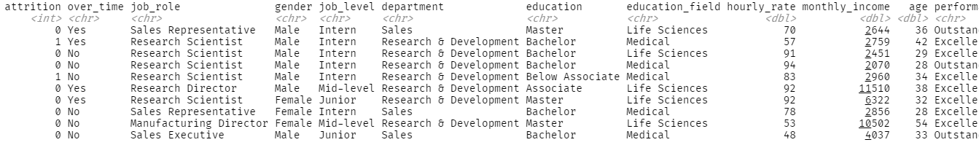
The data
employee_attrition (turnover)
IBM Watson HR data
~1500 rows x 30 columns

Slide 6
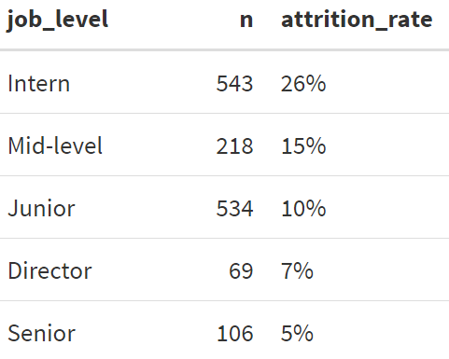
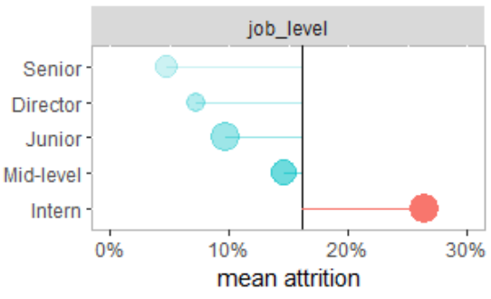
How does attrition vary by…
job_level
Overall avg turnover = 16%

Slide 7
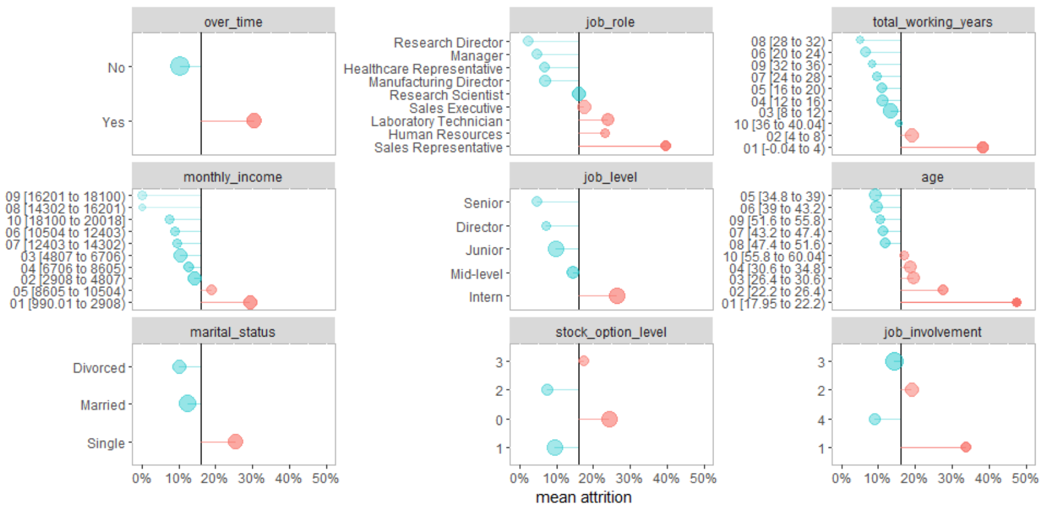
plot_deltas( df = employee_attrition, dep_var = "attrition" )

Slide 8
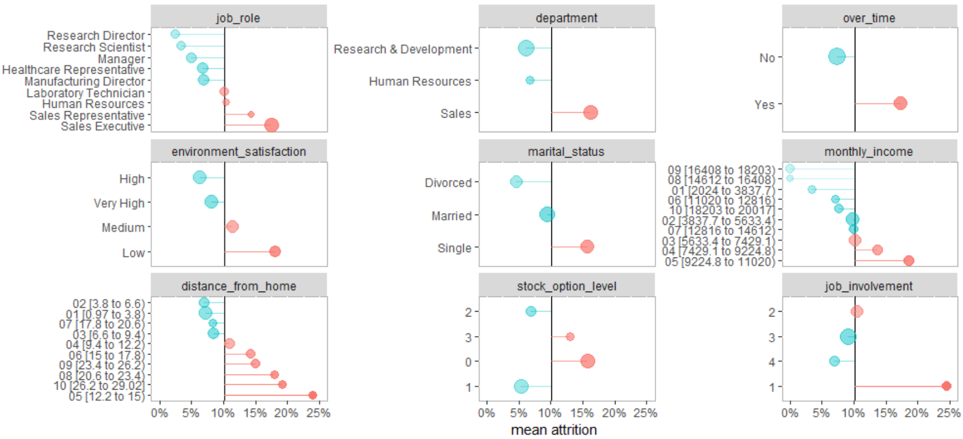
employee_attrition %>% filter(job_level != "Intern") %>% plot_deltas(dep_var = "attrition“)
Mean now 10%

Slide 9
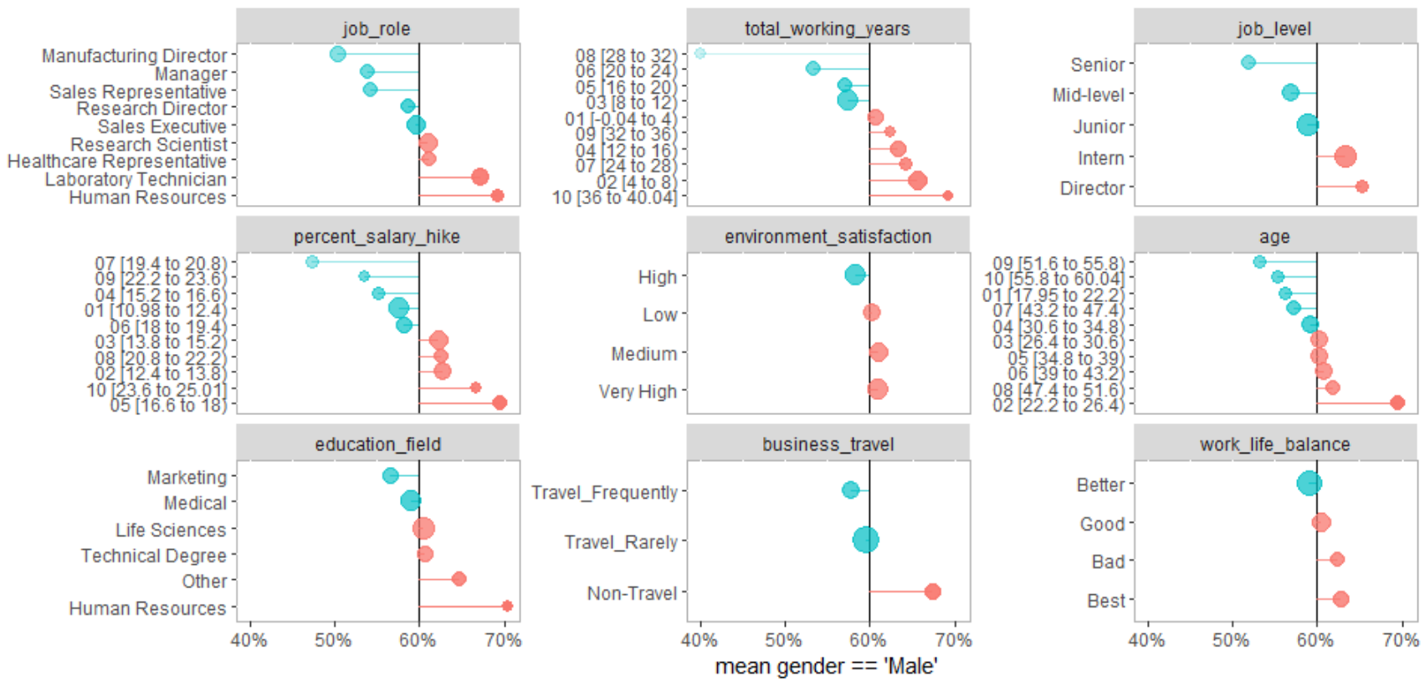
plot_deltas( df = employee_attrition, dep_var = "gender == 'Male'" )

Slide 10
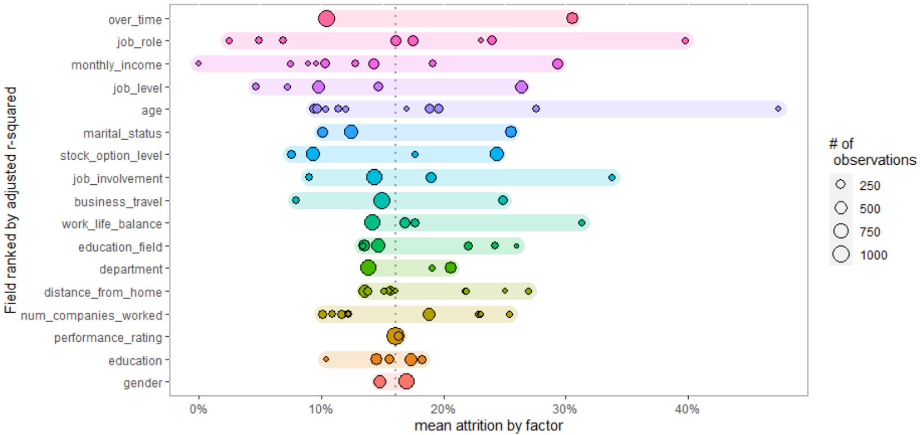
plot_spread(
df = employee_attrition,
dep_var = "attrition"
)
High variation, 2 large groups
High variation, several small groups
outlier
Small variation, 2 large groups

Slide 11
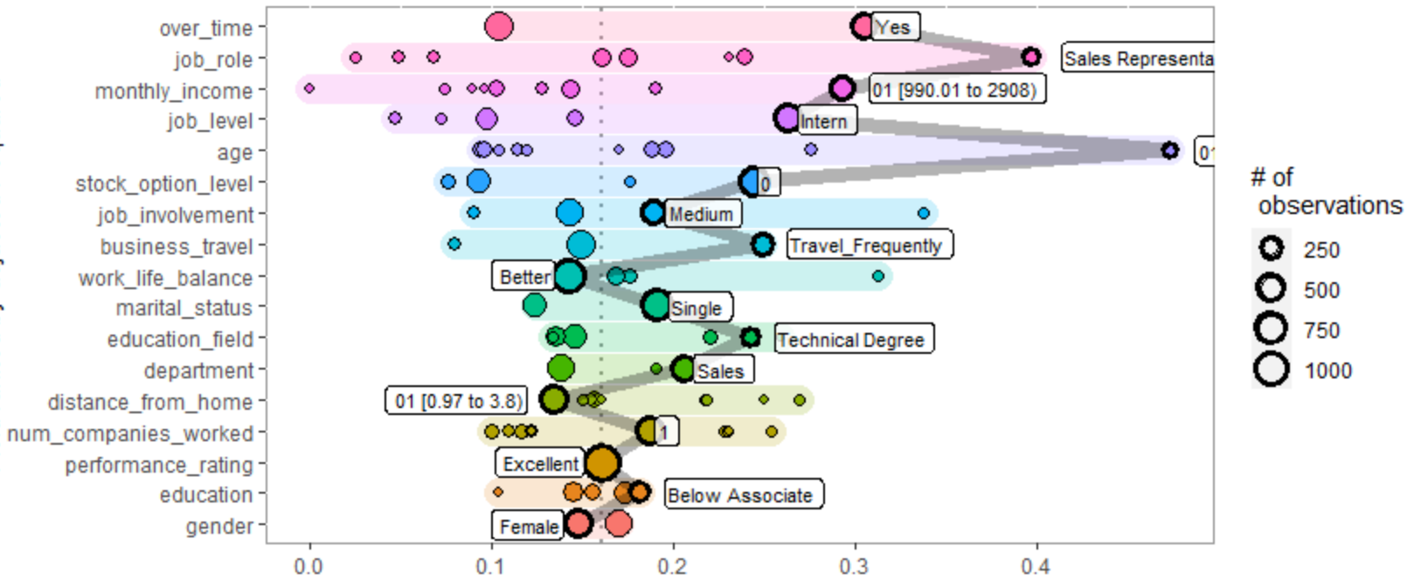
plot_spread_single_obs(
df = employee_attrition,
dep_var = "attrition",
id = 358,
labels = TRUE
)

Slide 12
Other functionality
Compare two groups (attendings vs residents)
% of all observations (what % of visits by attendings were fractures)
% within factor (what % of fractures were seen by attendings)
Volume (total # of visits)
Dependent variable (length of stay in hospital)
Interactive charts (plotly)
Return data

Slide 13
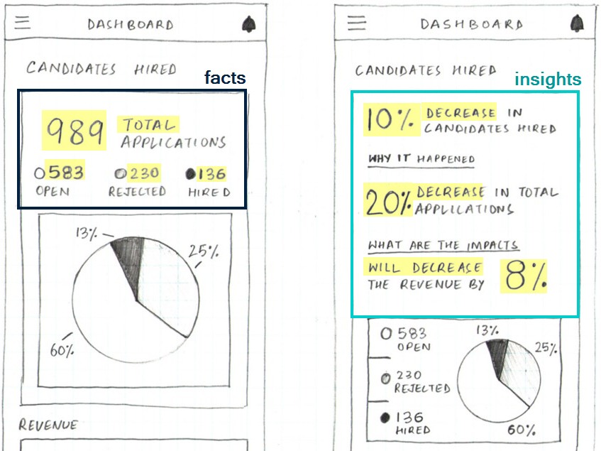
Building insightful dashboards isn’t easy
Facts
Easy out of the box
Risk of low adoption if takeaway isn’t obvious or actionable
Insights
More meaningful
High risk of technical debt

Slide 14
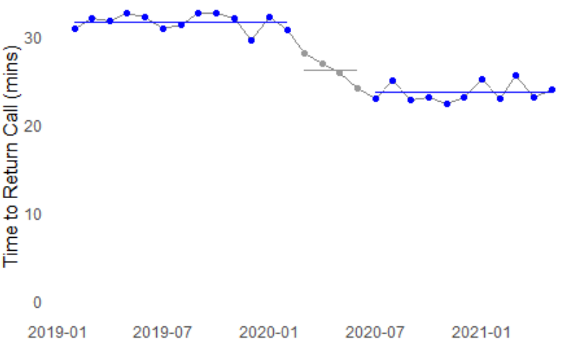
What’s a good title for this chart?
“Callback response times by month”
Vague
No insight
No lift
Static
“The avg. callback time has changed from 32 to 24 mins.”
Manual
Okay insights
Light lift
A little dynamic
“The avg. callback time has decreased by 8 minutes since COVID began (24 vs 32)”
Custom function
Good insights
Heavy lift - a few hundred lines of code to do well
Very dynamic

Slide 15

Enter headliner
headliner is an R package focused on informative titles
Given two values, headliner gives metadata about the difference
headline(32, 24)
#> increase of 8 (32 vs. 24)
headline(24, 32)
#> decrease of 8 (24 vs. 32)
headline(24, 32, return_data = TRUE) %>% view_list()
8 delta
25 delta_p
an 8 article_delta
a 25 article_delta_p
-8 raw_delta
-25 raw_delta_p
a -8 article_raw_delta
a -25 article_raw_delta_p
-1 sign
decrease trend
24 vs. 32 orig_values
Talking points

Slide 16
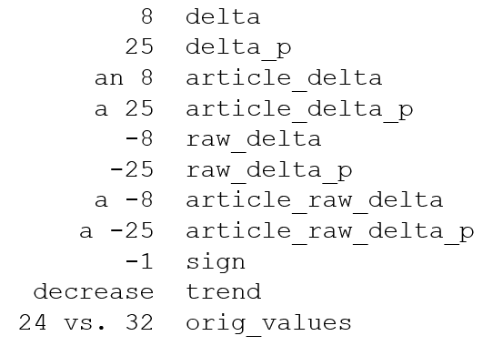
Enter headliner
Using glue()syntax, you can string together talking points:
my_age <- 36
glue("I am {my_age}")
#> I am 36
headline(
24, 32,
headline =
"The avg. callback time has {trend}d by {delta} minutes since COVID began ({orig_values})"
)
“The avg. callback time has decreased by 8 minutes since COVID began (24 vs 32)”
Dynamic insights
Very little code
Lower technical debt

Slide 17
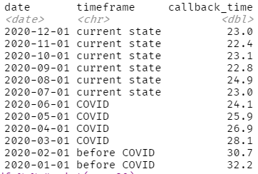
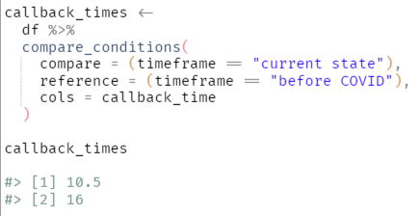
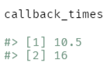
Helper functions
Aggregate metrics based on conditions

Slide 18
Calculations are completely soft-coded
Easily pass to headliner
callback_times %>%
headline(
headline =
"The avg. callback time has {trend}d by {delta} minutes since COVID began ({orig_values})"
) #> The avg. callback time has decreased by 8 minutes since COVID began (24 vs. 32)
Notes:
Dashboards & Reports
Put the metrics with the largest differences at the top
Emails
Qlik + R integration

Slide 19
Adding headlines row-by-row
df %>% add_headline_column(
compare = hours_asleep,
reference = hours_awake,
headline = "The {common_name} spends {delta} more {hours} {more} than {less}.",
plural_phrases = list( hours = plural_phrasing(single = "hour", multi = "hours") )
)

Slide 20
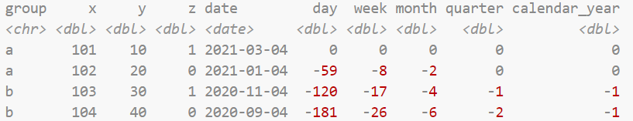
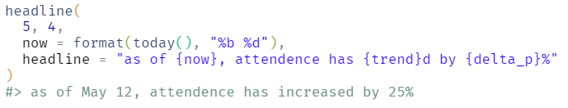
Other functionality
add_date_columns(date_col = date)
Helper function for comparing date ranges
[month = 0 vs month = -12]
Other benefits of glue()
Can add together
Can reference other variables

Slide 21

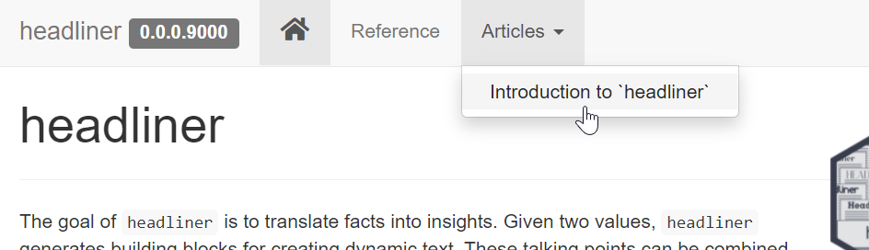
Thank you
github.com/rjake/
headliner
whereiation

Slide 22
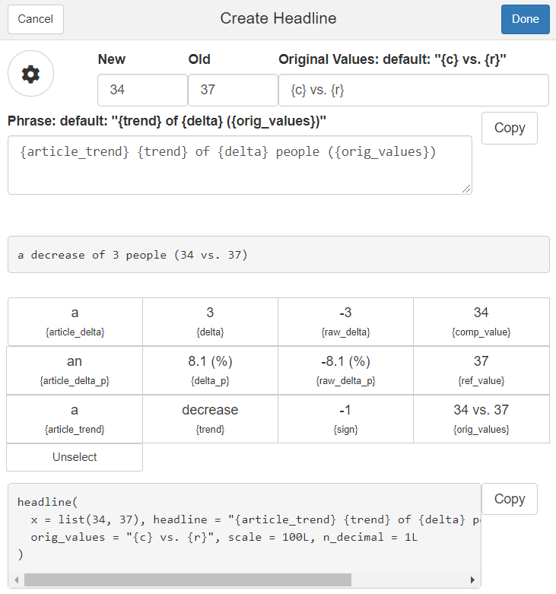
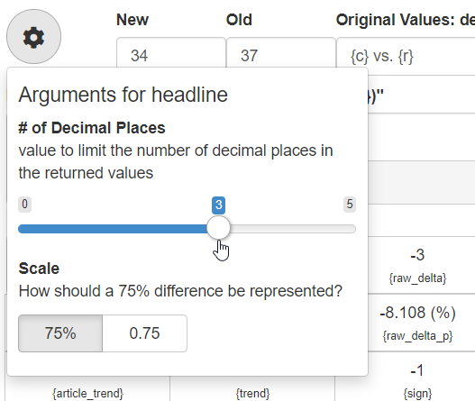
Working on a shiny add-in

Slide 23
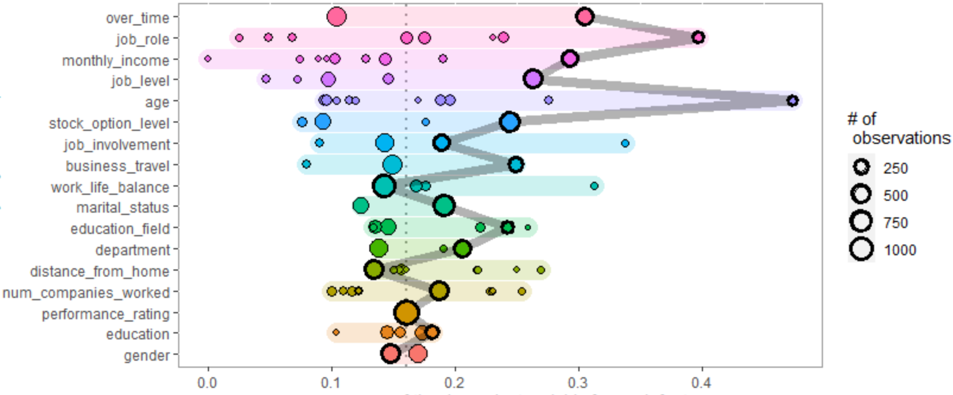
plot_spread_single_obs(
df = employee_attrition,
dep_var = "attrition",
id = 358
)

